Slide 1
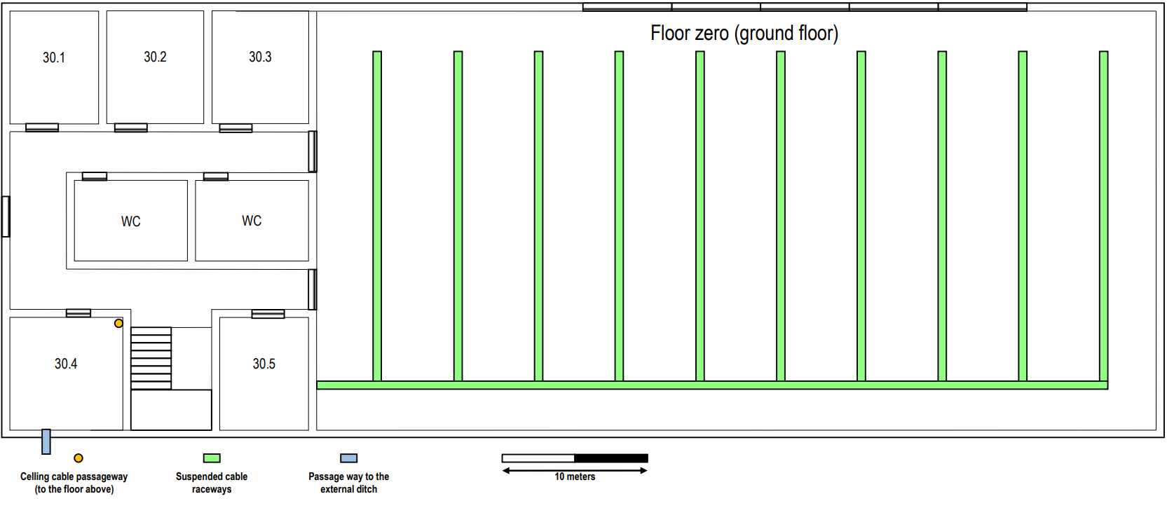
Intermediate cross-connect
2 Optical fibers
Horizontal cross-connect
Copper cable (CAT6A)
Wireless coverage area
Access Point
Copper cable outlets

Slide 2
Intermediate cross-connect
2 Optical fibers
Horizontal cross-connect
Copper cable (CAT6A)
Access Point
Copper cable outlets

Slide 3
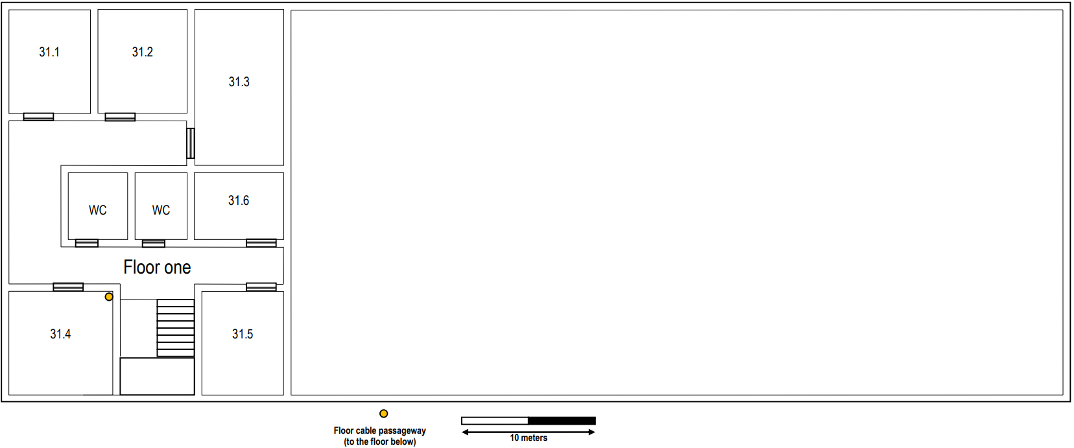
Horizontal cross-connect
Copper cable (CAT6A)
Access Point
Copper cable outlets
2 Optical fibers
Wireless coverage area

Slide 4
Horizontal cross-connect
Copper cable (CAT6A)
Access Point
Copper cable outlets
2 Optical fibers

Slide 5
10.124.176.0/23
512 endereços e 510 hosts
10.124.176.0/24
256 endereços e 254 hosts
10.124.177.0/24
10.124.177.255/24
256 endereços e 254 hosts
10.124.176.0/25
128 endereços e 126 hosts
10.124.176.128/25
128 endereços e 126 hosts
DMZ
10.124.176.0/26
10.124.176.63/26
64 endereços e 62 hosts
10.124.176.64/26
10.124.176.127/26
64 endereços e 62 hosts
10.124.176.128/26
10.124.176.191/26
64 endereços e 62 hosts
10.124.176.192/26
10.124.176.255/26
64 endereços e 62 hosts
End user outlets on the ground floor
End user outlets on floor one
Wi-Fi network
VoIP (IP-phones)

